Slide 1
Introduction to C Programming
Data Structures and Algorithms - I
2020
Odd Sem
1

Slide 2
What is Compiler in C?
A compiler is a computer program that transforms human readable (programming language) source code into another computer language (binary) code.
A compiler or interpreter is itself a computer program.
It accepts a program written in a high-level language (e.g., C) as input, and generates a corresponding machine-language program as output.
C compiler is a software application that transforms human readable C program code to machine readable code.
The process of transforming the code from High Level Language to Machine Level Language is called “Compilation”.

Slide 3
C Programming Introduction
C is a powerful general-purpose programming language.
C Programming is fast, easy, portable, highly efficient and available on all platforms.
That’s the main reason behind its popularity despite being
nearly 50 years old.
Standard C programs are portable.
The code written in one system works in another operating system without any change.

Slide 4
C History & Standardization
C evolved from two previous languages, BCPL and B.
The C language was developed by Dennis Ritchie at Bell Laboratories and was originally implemented in 1972.
C initially became widely known as the development language of the UNIX operating system.
The rapid expansion of C over various types of computers (sometimes called hardware platforms) led to many variations that were similar but often incompatible.
Consequently, the American National Standards Institute(ANSI) developed a standardized (X3) definition of the C language.
Revised standard came in 1999 known as C99. New C standard is C11.
Virtually all commercial C compilers and interpreters now adhere to the ANSI standard. Many also provide additional features of their own.

Slide 5
Early Development of C Programming
Since then C Language became the most widely used programming languages of all time with C compilers from various manufacturers available for the majority of existing computer architectures and operating systems.
C has been standardized by the (ANSI) American National Standards Institute in 1989 as called ANSI C and subsequently by the International Organization for Standardization (ISO).
In 1978, Brian Kernighan and Dennis Ritchie published the first edition of C Programming Language book known to C programmers as “K&R C”, served as an informal specification of the language for many years.
The 2nd edition covers the ANSI C standard, described below.

Slide 6
K&R introduced several language features:
Standard I/O library
long int data type
unsigned int data type
Important NOTE: In early versions of C, functions that do not
have return type has “INT” as default return type.

Slide 7
C relation with other Programming languages
Many languages developed after C language existence have their syntax or library files written directly or indirectly in C,
including C++, JavaScript, C#, Java, Unix’s C shell, D, Go, Limbo, LPC, Objective-C, Perl, PHP, Python, Rust, Swift, and Verilog (hardware description language).
These languages got many of their control structures and other features from C.
Most of them have their syntax very similar to C programs in general, and if you know C programming then you can easily understand compile or debug most of the languages without knowing it properly.

Slide 8
Overview of C Programming
C is also a structured programming language and allowing variable scope and recursion.
In C, all executable code is divided into subprogram called as
“Functions”.
Function parameters are always passed by value.
Pass-by-reference is achieved in C by explicitly passing pointer values while calling the function.
C program source is a simple text, free from any format and a semicolon at the end of each line called “Statement terminator” and curly braces for grouping blocks of statements.

Slide 9
The C language has the following characteristics:
C has a rich set of keywords, including the set of control flow statements such as for, if/else, while, switch, and do/while.
C has a large number of arithmetical and logical operators, such as,+, +=, ++, &, ~ etc.
More than one variable assignment can be performed in a single statement separated by a comma.
All data and variables have a type, but implicit conversions may be performed during
execution.
User-defined (typedef) data type and compound types are possible.
“Struct” datatype allows the user to group co-related different data type elements in a single user-defined datatype.
Union is a structure with only the last initialized member has valid memory and Union gets
the memory size of the largest datatype it contains.
Pointers allow Low-level access to computer memory.
A preprocessor directives used to performs macro definition, source code file inclusion, and conditional compilation.
13

Slide 10
APPLICATIONS OF C LANGUAGE
C language used in creating computer applications and Embedded software.
Firmware for industrial and communications products which uses micro- controllers.
Used in developing Compiler for different Languages which covert input from other language into lower level machine language.
C is used to implement different OS Operations.
UNIX kernel is developed in C Language.
C & C++ used in developing VLC player.
C language is also used in database engines and Device driver development.
Note: C does not include some features found in other languages, like object orientation or garbage collection, such features can be implemented or emulated in C, often by way of external libraries (e.g.,GLib Object System or
the Boehm garbage collector ).
14

Slide 11
C ‘main’ function and Standard Library
Every C program consists of one or more modules called functions.
A function contains statements that specify the computing operations to be done.
The C Standard Library is a rich collection of existing functions.
You can also program all the functions that you need to form a C program.
Normally you are at liberty to give functions whatever names you like, but "main" is special.
The program will always begin by executing the main function.
This means that every program must have a main somewhere.
main will usually call other functions to help perform its job, some that you wrote, and others from libraries that are provided for you.

Slide 12

Why Should You Learn C Language?
C is versatile
C is the mother of all languages.
C is an old language.
C is portable.
C is simple.
C is 'free'.

Slide 13
Running a C Program Using GNU C Compiler (gcc) with Linux
Write your program in any editor (vi, gedit) and save your file with .c extension
To compile, type
gcc filename for eg., gcc test.c
this will create a.out file (if no syntax error)
OR
gcc test.c -o output or gcc -o output test.c
This line invokes the C compiler called gcc, asks it to compile test.c and asks it to create the executable file with the name output
To run the program, type
./a.out
./output
OR

Slide 14
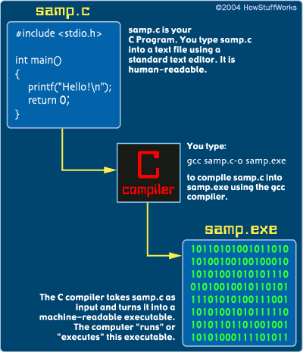
How to compile and run a C program

Slide 15
First C Program
/* First C
Program*/
/*multi-line comments*/
// A first program in C
//Single line comment
#include <stdio.h> main()
{
//first line of code
printf(“Welcome to the world of Programming\n");
}

Slide 16
First C Program
Line 1: #include <stdio.h>
(Preprocessor Directive)
This line includes the "standard I/O library" into your program.
The standard I/O library lets you read input from the keyboard (called "standard in"), write output to the screen (called "standard out"), process text files stored on the disk, and so on. It is an extremely useful library.
C has a large number of standard libraries like stdio, including string, time and math libraries.
A library is simply a package of code that someone else has written to make your life easier.
As part of compilation, the C compiler runs a program called the C preprocessor. The preprocessor is able to add and remove code from your source file.
In this case, the directive #include tells the preprocessor to include code from the header file stdio.h.
This file contains declarations for functions that the program needs to use. A declaration for the printf function is in this file.

Slide 17
First C Program
Line 2: void main()
This statement declares the main function.
C program can contain many functions but must always have one main function.
The parentheses after main indicate that main is a program building block called a function.
A function is a self-contained module of code that can accomplish some task.
Every program in C begins executing at the function main.

Slide 18
First C Program
Line 3: {
A left brace, {, begins the body of every function.
A corresponding right brace } ends each function.

Slide 19
First C Program
Line 4: printf(“Welcome to the world of Programming\n");
printf is a function from a standard C library that is used to print strings to the standard output, normally your screen.
The backslash (\) is called an escape character.
When encountering a backslash in a string, the compiler looks ahead at the next character and combines it with the backslash to form an escape sequence.
The escape sequence \n means newline, causes the cursor to position to the beginning of the next line on the screen.
If there were another printf in this program, its string would print on the next line.

Slide 20
How to excecute the above program:
Inorder to execute the above program, we need to have a compiler to compile and run our programs.
There are certain online compilers
like https://ide.geeksforgeeks.org/, http://ideone.com/ or http://co depad.org/ that can be used to start C without installing a compiler.
Windows: There are many compilers available freely for compilation of C programs like Code Blocks and Dev-CPP.
Linux: For Linux, gcc comes bundled with the linux, Code Blocks can also be used with Linux.
Data Structures and Algorithms - I
Odd Sem 2020
24

Slide 21
The C Character Set
Alphabets
A, B, ….., Y, Z
a, b, ……, y, z
Digits
0, 1, 2, 3, 4, 5, 6, 7, 8, 9
Special symbols
~ ‘ ! @ # % ^ & * ( )
_ - + = | \ { } [ ] : ; " ' < > , . ? /

Slide 22
C Tokens
A token is the smallest element of a program that is meaningful to the compiler. Tokens can be classified as follows:
Keywords
Identifiers
Constants
Strings
Special Symbols
Operators
26

Slide 23
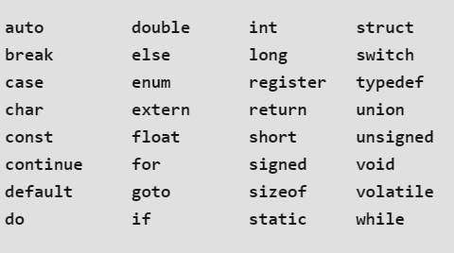
C Keywords
There are certain reserved words, called keywords, that have standard, predefined meanings in C.
These keywords can be used only for their intended purpose; they cannot be used as programmer-defined identifiers.
The keywords cannot be used as variable names.
C supports 32 keywords

Slide 24
IDENTIFIERS
Identifiers are names that are given to various program elements, such as variables, functions and arrays.
Identifiers consist of letters and digits, in any order, except that the first character must be a letter.
Both upper- and lowercase letters are permitted, though common usage favors the use of lowercase letters for most types of identifiers.
Upper- and lowercase letters are not interchangeable (i.e., an uppercase letter is not equivalent to the corresponding lowercase letter.)
The underscore character ( _ ) can also be included, and is considered to be a letter.
An underscore is often used in the middle of an identifier. An identifier may also begin with an underscore, though this is rarely done in practice.

Slide 25
_{IDENTIFIERS}
Valid identifiers
number
year_17
_name
GRADE
DIV_7
Example:
int main()
{
int a=10; return 0;
}
Invalid identifiers
123ab
mobile-no.
first name
email@id
In this program there are 2 identifiers:
main: method name.
a: variable name.

Slide 26
Escape Sequence
Certain nonprinting characters, as well as the backslash (\) and the apostrophe ( ‘ ), can be expressed in terms of escape sequences.
An escape sequence always begins with a backward slash and is followed by one or more special characters.
For example, a line feed (LF), which is referred to as a newline in C, can be represented as \n.
Such escape sequences always represent single characters, even though they are written in terms of two or more characters.
The commonly used escape sequences are listed below.

Slide 27
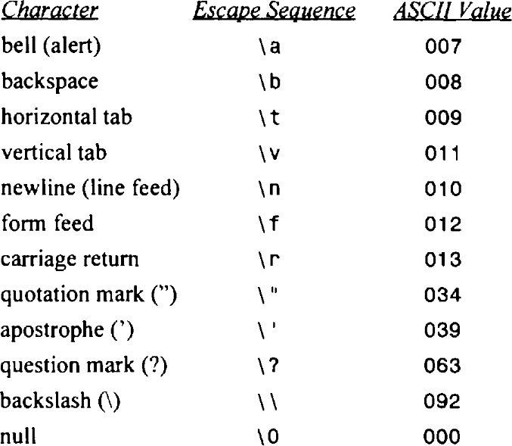
Escape Sequence

Slide 28
Variables in C
Variables are memory locations(storage area) in C programming language.
The main purpose of variables is to store data in memory for later use.
Variables value may change during execution.
If you declare a variable in C, that means you are asking to the operating system for reserve a piece of memory with that variable name.
Each variable in C has a specific type, which determines the size and layout of the variable's memory; the range of values that can be stored within that memory; and the set of operations that can be applied to the variable.
While you can have multiple variables of the same data type, you cannot have multiple variables with the same name.

Slide 29
Variable Declaration in C
A declaration consists of a data type, followed by one or more variable names, ending with a semicolon.
Syntax:
type variable_name;
or
type variable_name, variable_name, variable_name;
Here, type must be a valid C data type including char, int, float, double, or any user-defined object; and variable_name is an identifier name separated by commas.

Slide 30
Variable Declaration in C
C compiler is able to distinguish between the variable names by making it compulsory for you to declare the type of any variable name that you wish to use in a program.
Any variable used in the program must be declared before using it in any statement.
A declaration associates a group of variables with a specific data type.
E.g. int MIS_no;
float marks, percentage; char grade;

Slide 31
Variable Definition in C
A C program contains the following type declarations.
short int a, b, c;
long int r, s, t;
int p, q;
The above declarations could have been written as
short a, b, c;
long r, s, t ;
int p, q;
Thus, short and short int are equivalent, as are long and long int .

Slide 32
Variable Initialization in C
Initial values can be assigned to variables within a type declaration.
To do so, the declaration must consist of a data type, followed by a variable name, an equal sign (=) and an expression, the expression serves as an initializer. A semicolon must appear at the end.
Syntax:
type variable_name = value;
E.g.
int d = 3, f = 5;
char x = ‘a';
int c = 12;
float sum = 0.1 ;
double factor = 0.21023e-6; value is 0.21023 x 10-6 */
// definition and initializing d and f
// the variable x has the value ‘a'.
/*factor is a double-precision variable whose initial

Slide 33
Variable in C
A restriction on variables is that variable declarations must come before other types of statements in the given "code block" (a code block is just a segment of code surrounded by { and } ). So in C you must declare all of your variables before you do anything else:
Wrong
#include <stdio.h> int main()
{
/* wrong! The variable declaration must appear first */ printf("Declare x next" );
int x; return 0;
}
Fixed
#include <stdio.h> int main()
{
int x;
printf("Declare x first" ); return 0;
}

Slide 34
Format specifiers
It tells the compiler that which type of value you want to print or
read.
Example:
printf(“%d”, a);
Here %d is format specifier and it tells the compiler that we want to print an integer value that is present in variable a.
Format specifier is a special character in the C language used to specify the data type of value.
Format specifiers start with a percentage % operator and followed by a special character for identifying the type of the data.

Slide 35


Format specifiers
Format specifier | Description
%d | Integer Format Specifier
%f | Float Format Specifier
%c | Character Format Specifier
%s | String Format Specifier
%u | Unsigned Integer Format Specifier
%ld | Long Int Format Specifier
Format specifiers are also called as format string.

Slide 36
Data Types in C
The C language has a rich set of data types to handle different kind of data entered by programmer.
Basically a data type informs compiler about how much memory a declared variable required to store input.
Data types are used extensively for declaring variables and functions of different types.

Slide 37
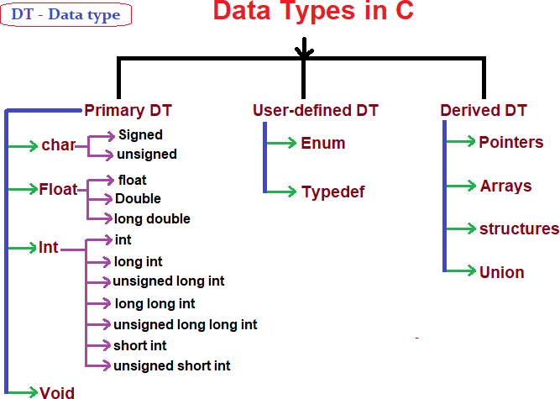

Slide 38
Signed vs Unsigned
The term "unsigned" in computer programming indicates a variable that can hold only positive numbers.
The term "signed" in computer code indicates that a variable can hold negative and positive values.
The property can be applied to most of the numeric data types including int, char, short and long.

Slide 39
Unsigned Variable Type of Integer
An unsigned variable type of int can hold
zero and positive zero and positive
numbers, and a signed int holds negative, numbers.
In 32-bit integers, an unsigned integer has a range of 0 to 2³²-1 = 0 to 4,294,967,295 or about 4 billion.
₍₂31
The signed version goes from -2³¹-1 to -1 ) which is –
2,147,483,648 to 2,147,483,647 or about -2 billion to +2 billion.
An int type in C, C++, and C# is signed by default.
If negative numbers are involved, the int must be signed; an unsigned int cannot represent a negative number.

Slide 40
DATA TYPES
range/values of data types
signed = -2^(n-1) to (2^(n-1))
unsigned = 0 to (2^n) -1

Slide 41
Primary Data Types
Primary data types are those which are already defined in programming languages also known in-built data types.
These data types are basic building blocks of any programming language and numerous composite data types are constructed from this basic type.
We can check the memory size of any variable by using sizeof() operator and a format specifier %lu.

Slide 42
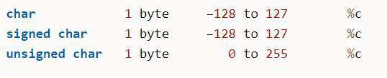
Character Types:
A single character in C is of “char” type data.
Characters stored in 8 bits or 1 byte of memory and the character can also be signed and unsigned.
Signed and unsigned char both used to store single character as per their ASCII values.
For example, ‘A’ will be stored as 65. we don’t need to specify keyword ‘signed’ for using signed char.
char ch=’a’;
printf(“size of character %lu”,sizeof(ch));

Slide 43
Integer Types:
hold only integer values.
stores values in range limited from -2147483648 to 2147483647.
A signed integer uses one bit for sign out of 16 bits.
The integers classified into three classes of storage with both signed and unsigned qualifier based on the range of values held by them.

Slide 44
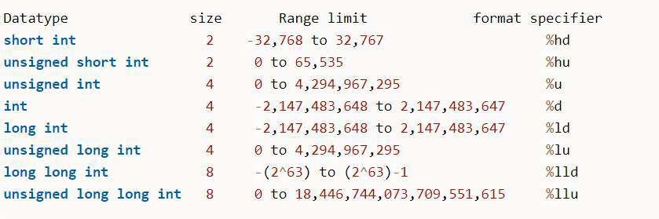

Slide 45
int (1 sign bit + 31 data bits) keyword in C
Example – Consider,
int num=2147483647;
At this point first 2147483647 will be converted into its binary form which is equal to:
1111111111111111111111111111111.
1111111111111111111111111111111 is a 31 digit binary number which will be assigned to variable num’s right most 31 bits and the 32nd bit will have a zero(0) as the number being assigned to variable num is a positive number. If we try to store any number greater than 2147483647 into an
‘int’ type variable then we will lose information.

Slide 46
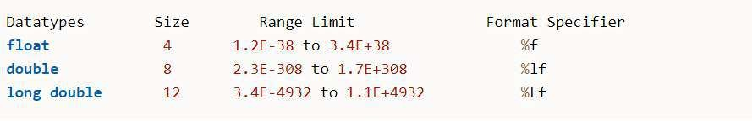
Floating Point Types:
Data type ‘float’ used to stores real numbers in 32 bits with up
to 6 decimal points precision.
The double type also similar to float stores in 64 bits with more accurate precision up to 14 decimals and Long double further extends the precision using 80 bits and 19 decimal places.

Slide 47
printf ()
printf() stands for print formatted string.
printf is a predefined function in "stdio.h" header file, by using this function, we can print the data or user defined message on console or monitor.
Syntax
printf("user defined message");
Syntax
printf("Format specifers",value1,value2,..);
Example:
int a=10; printf(“%d”, a);
Note- %% Outputs a percent sign.

Slide 48
Mixing Literal Text and Variables Values
We now know that we can output a string literal:
printf("This will be the output \n");
We also know that we can output the value of a variable:
printf("%d", distance);
We can output the values of multiple variables in a single printf():
printf("%d %f", distance, time);
Not surprisingly, we can mix and match the two:
printf(“You are %d miles away\n", distance);
We can even mix and match while outputting the values of multi variables of various data types:
printf("The %d distance remaining. It will take %f time\n“, distance, time);

Slide 49
scanf()
scanf() stands for scan formatted string.
scanf() is a predefined function in "stdio.h" header file.
It is used to read the input value from the keyword.
Syntax
scanf("format specifiers",&value1,&value2,.....);
E.g.
int var; scanf("%d",&var);
The address-of operator (&) preceding a variable i.e. &var indicates the memory location of variable 'var'.
Note- For using I/O functionality, programmers must include stdio header-file within the program.

Slide 50
